Slide 2
Login https://www.hatchearlylearning.com/

Slide 3
Click on Login > Hatch Insights

Slide 4
Type your work email and password

Slide 5
If it’s the first time you login, you must complete the follow steps, click Next

Slide 6
Click Finish Setup

Slide 7
Then, click Next

Slide 8
Click Maybe Later- Finish Setup

Slide 9
You will now see this website where you can find - Current Class Progress - Ignite Play Schedule - Small Group Activity - Support Needed - Average Play Time - Teaching Strategies GOLD And on top you will find: - Reports - Class Management - Games - Account

Slide 10
If you click Class Management > View All Children

Slide 11
You can Add a Child >
Edit Info of your students
You will be able to see All Children in your Class

Slide 12
To add a child you need to put a temporary picture of the child and fill out all the information required

Slide 13
For a student to play at home, you must first fill out Parent information
(Please, don’t forget to put a temporary picture)

Slide 14
Parents will receive an email from
no_reply_ignite@hatchearlylearning.com
With the temporary password in
Pink letters

Slide 15
If a parent does not receive the email with a temporary password, you can click on Class Management > View all parents

Slide 16
Click Resend Invite, and Hatch will send another temporary password

Slide 17
Current Class Progress: You will be able to see the progress of your students They need to play at least 30 min per week

Slide 18
If you click in Play Time Report, you will be able to see how much time your students have been playing

Slide 19
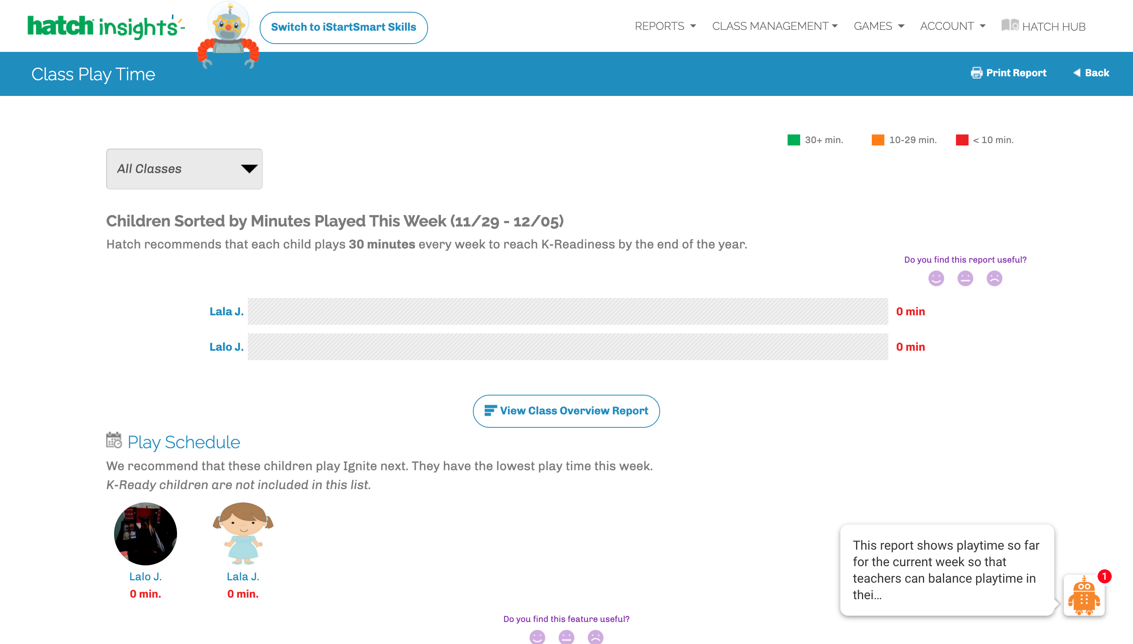
You will find the time here

Slide 20
If you click in Manage GOLD Connection, you will be able to see your students matched with GOLD profile, please make sure the language is match in TSG and Hatch

Slide 21
If you have found some mismatched language, please make sure you match them, once you finish you must click in Done- Time to Match Children to GOLD

Slide 22
If you have a student that did not receive a Hatch Tablet, parents can download the app on their personal phones or tablets. Application is found in Google Play or App Store as: Ignite by Hatch

Slide 24
Please keep in mind: All the time they spend playing in Ignite by Hatch, it will hep you with your observations in Teaching Strategies

